Slide 1
Continuous Deployment in mobile applications
Brandon H
@bc3tech – http://bc3.tech
Principle Mobile Architect – Microsoft Platforms

Slide 2
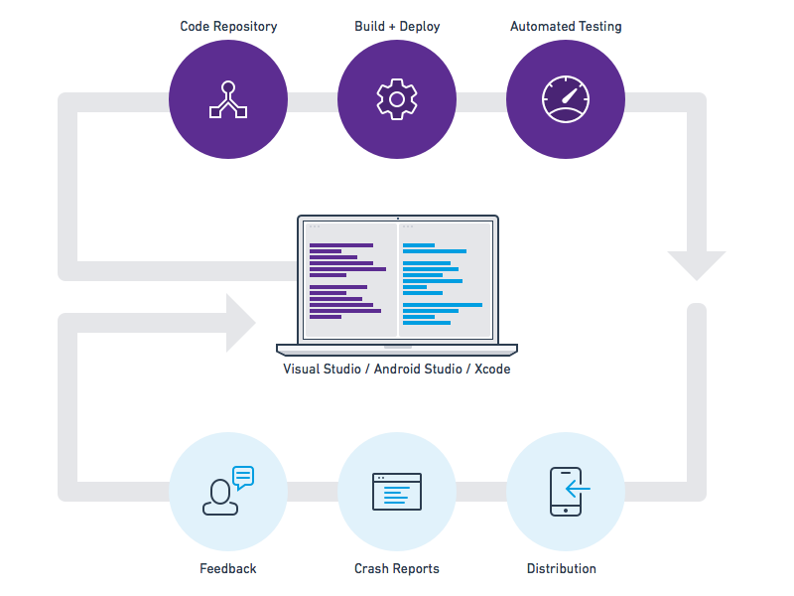
What do we mean by “Mobile DevOps”?
Streamlining the development of your mobile app(s)
Frequently releasing value to users
Constantly maintaining quality
Monitoring app health and engagement in real-time
Automating the process to be repeatable & sustainable
Continuous Integration (CI)
Continuous Delivery (CD)
Continuous Monitoring (CM)

Slide 3
Continuous Integration (CI)
How can you iterate quickly, while still maintaining quality?
Recommendations:
Setup an automated build server
that runs on every check-in
Author automated tests and run them as part of your build
Use a test cloud to achieve high device coverage

Slide 4
Visual Studio Team Services (VSTS) / TFS
Version Control
Git and Team Foundation Version Control (TFVC)
Unlimited private repos
Agile Planning
Work item tracking
Kanban, backlogs, task boards
Continuous Integration
Cloud-hosted build agents
Build support for all mobile platforms
Integration with test clouds

Slide 5
Demo
Step #1: Setting up Xamarin CI w/VSTS and blank X.Forms project

Slide 6
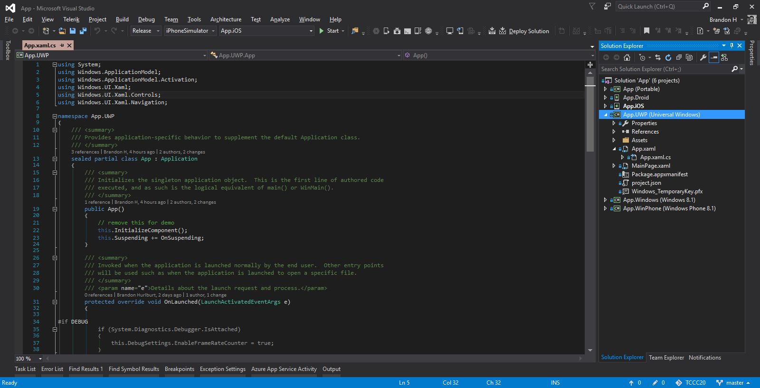

Slide 7
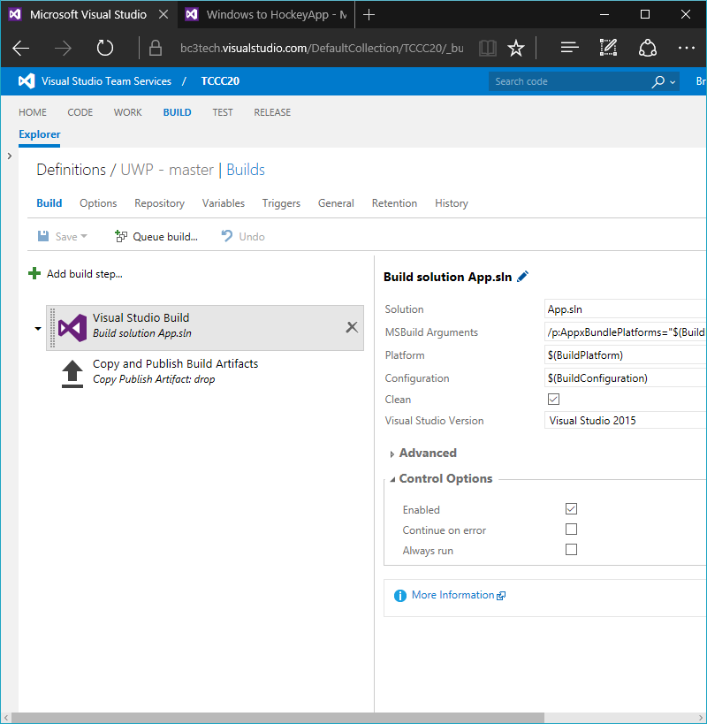

Slide 8
Continuous Delivery (CD) - Beta
How can you get early feedback from your testers on every build?
Recommendations:
Conduct a continuous beta program to collect feedback
Automate the deployment of new builds from your CI server
Monitor crash reports to catch issues early

Slide 9
HockeyApp
Distribution
In-house app store
Notify testers of updates
Crash Reporting
Real-time collection
“Symbolicated” stacks
Feedback
Gather in-app feedback
Respond directly to testers

Slide 10
Demo
Step #2: Distributing builds to beta testers w/HockeyApp

Slide 11
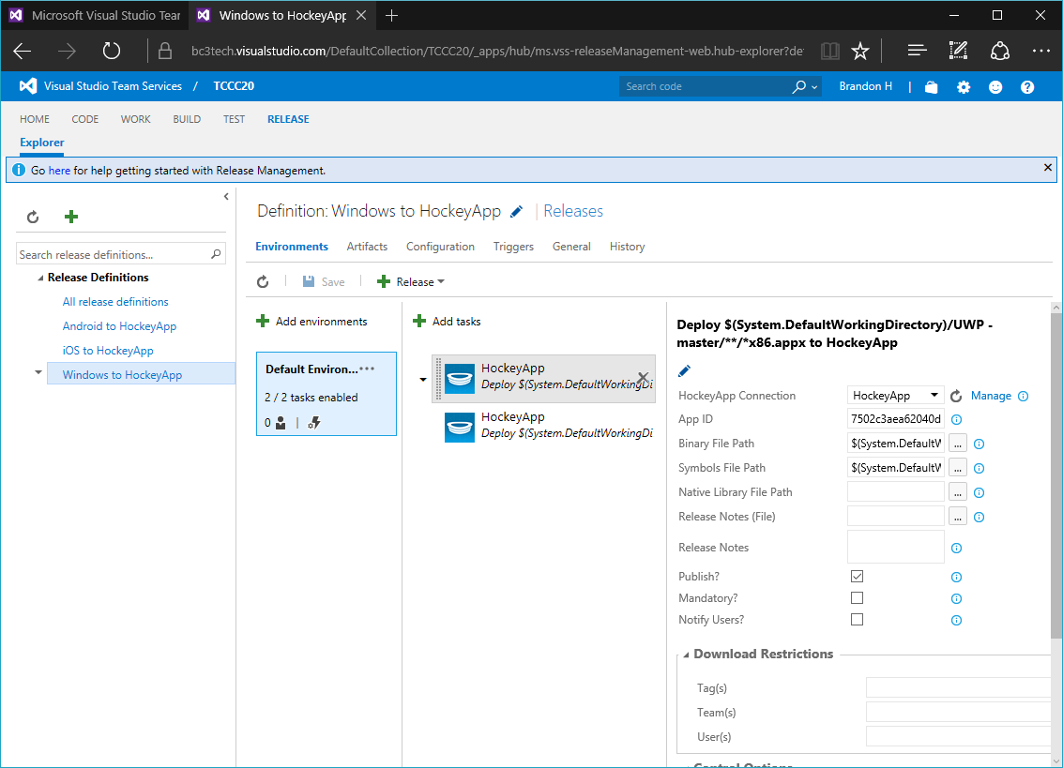

Slide 12
Continuous Delivery (CD) - Production
How can you automate your production deployments once a release is signed-off?
Recommendations:
Setup a multi-environment release process (e.g. beta and production)
Assign the necessary stakeholders to sign-off on beta/staging builds
Automate as much of this workflow as possible

Slide 13
Release Management (VSTS)
Continuous Delivery
Define per-environment release pipeline
Trigger manually or via successful builds
Approval Policies
Configure per-environment sign-offs
Manual validation requirements
Release Visibility
View per-environment release status
Track release back to commits

Slide 14
Demo
Step #3: Release Management w/VSTS and HockeyApp

Slide 15
Continuous Monitoring
How can you better understand your users and how they engage with your app?
Recommendations:
Track DAU/MAU to understand user acquisition and retention
Instrument your app with custom events to better understand user engagement of specific features
HockeyApp = cross-platform and growing in this space (App Insights, Xam Insights)
?

Slide 16
Additional Resources
Check out the following resources for more info:
  3-part blog series: http://bc3.tech/xplat-cd-tccc20
  VSTS – http://visualstudio.com
  HockeyApp – http://hockeyapp.net
Go through Microsoft’s the Mobile DevOps “code lab”: http://aka.ms/MobileDev1
Twitter: @bc3tech
Blog: http://bc3.tech

