Slide 1
Give your app some global appeal
Localizing your app using Microsoft’s Multilingual App Toolkit (MAT)

Slide 2
Why localize?
Many apps you write can be used anywhere in the world
Low-cost smartphones like Nokia’s 5__ and 6__ series and a host of Android phones are bringing the “app market” to less-industrialized parts of the world
English-only strings/text limits the appeal/usability of your app in these rapidly-growing markets

Slide 3
Case Study – Upload to YouTube
Adds functionality not currently present on Windows Phone to upload videos from your Camera Roll directly to YouTube
Task would be attractive to anybody, anywhere
Embed analytics to see where it’s most used

Slide 4
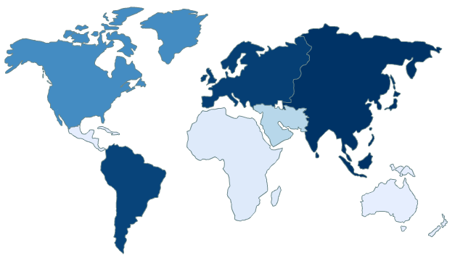
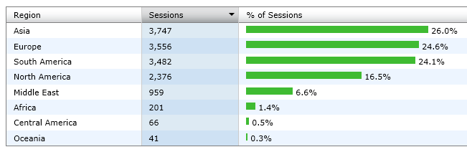
Upload to YouTube – Usage Statistics
- Geography

Slide 5
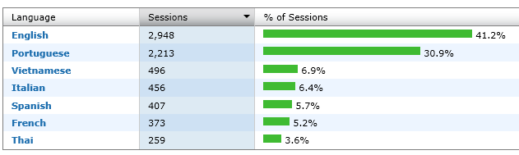
Upload to YouTube – Usage Statistics
- Language

Slide 6
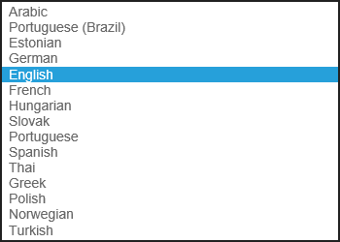
Upload to YouTube - Support

Slide 7
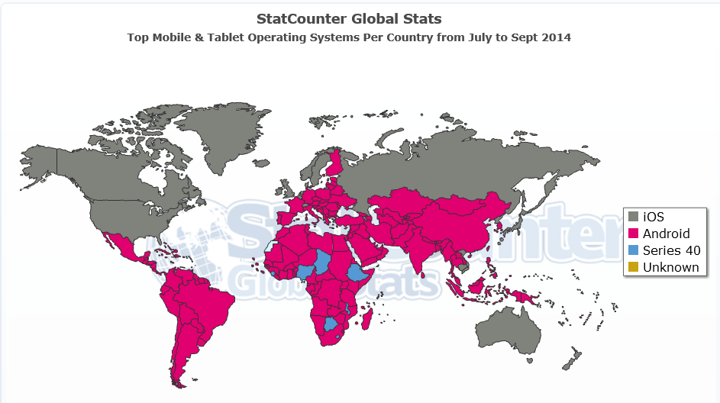
Other Mobile Operating Systems

Slide 8
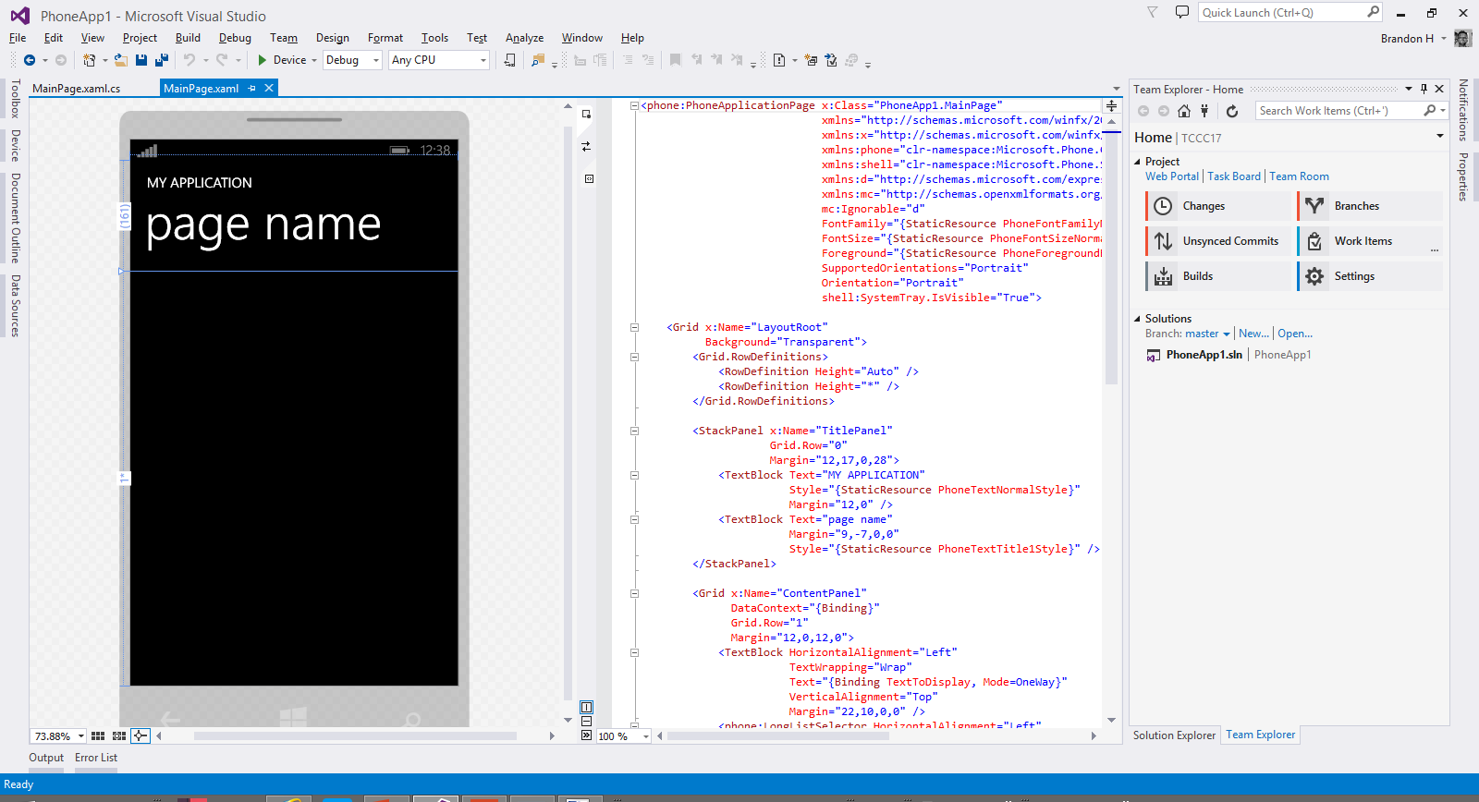

Slide 9
Feedback is appreciated!
Related Blog Posts: http://bc3te.ch/tccc17
My Contact Information

